Slide 1
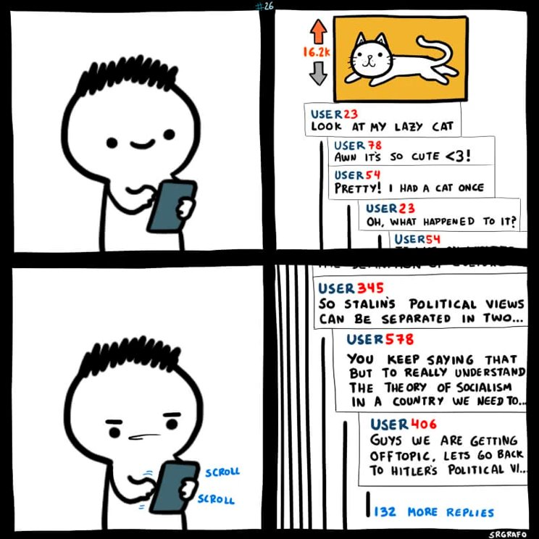
Notes:
First I'd like to take you through a simple scenario, there are many online forums out there where people are free to talk about whatever they want.
To maintain some rules and regulations we have social media moderators in these forums.
Moderators decide what goes and what stays.
Moderators – being humans – may also miss some occurrences of "unhealthy" irrelevant submissions in the forum.
Moderators themselves also risk introducing their own biases and influences on these discussions.
What we were interested in is if there's some way to remove human intervention in detecting "unhealthy" irrelevant conflict, biases and influences in these online forum discussions.
We want to detoxify forums that are often times seeds for spreading disinformation or even online bullying.

Slide 2
Finding Conflict and Identifying Biases in Social Media Forums using the TSAR System
Venkata Sai Muktevi (Sai)
Andrew Zhou (Andy)
Notes:
I'm Sai and today
Andrew and I will be presenting our work related to attempting to Find Conflict and Identifying Biases in online internet discussions on Social Media Forums.

Slide 3

Hello Reddit!
Andrew
Data Scientist @ Meta
Product Analytics
Sai
Data Scientist @ Microsoft
Retention and Growth Hacking on WebXT
Both Graduated March 2022 - UW Masters in Data Science Program
Here to talk about our Capstone Project '22!

Slide 4

Objectives What are people talking about and how do they feel?
Initial Goal and Motivations
Increase awareness of conflict, influence and biases in social media forums.
Make life easier for moderators.
What we have so far...
A way to identify trigger topics in discussions,
measure controversy using sentiments and
visualize the "health" of discussions in subreddits.
Notes:
So the first ask for this project which kinda kicked things off for us was initiated by our data science mentor from Meta:
The ask was: In small online groups and forums, what are people talking about and how they feel about these topics of discussion? Can we identify trigger topics that lead to unrest/conflict in online discussions?
This helped us formulate our Initial Goal and Motivation.
What we have so far...
A way to identify trigger topics in discussions,
Measure controversy/conflict using sentiments and
Visualize the "health" of discussions in subreddits.

Slide 5

The TSAR System
Topic Modeling of Posts and Comments
Sentiment Analysis of Posts and Comments.
Relevance of Comments to their Posts.
Notes:
The TSAR System is a data engineering pipeline that utilizes Natural Language Processing to analyze internet forum discussions using dedicated APIs depending on the source of data.
It consists of Topic Modeling, Sentiment Analysis and Relevance Scoring.
We will iteratively build on explaining the TSAR system and will dive deeper in technicality as we progress through.

Slide 6

Piecing Together TSAR - Scoring
Developing Topics and Sentiment scores.
Posts set the tone of discussion.
Negative sentiments usually indicate disagreement or conflict
Sentiment score deviation of comments w.r.t. their post - show polarity of discussion playing out.
Controversy score = comment sentiment score – post sentiment score
Comment Relevance scores – measuring "health" of discussion
Notes:
- First we used topic modeling for identifying topics in Posts and Comments of a forum.
- The sentiment analysis gave us a Sentiment Score for each post and comment.
- We believed that posts sentiment set a tone for discussion so we wanted to take that as a reference point for the comments that followed.
- From our studies we learned that negative sentiment in such forums is usually a good indicator of disagreement/conflicting views.
- With that idea, sentiment score deviation of comments wrt their posts would give us a degree of opposition or agreement of commenting users.
- Hence we developed our controversy score as …
- We also took into account relevance of comments to their posts as an important measure to identify health of discussion.

Slide 7

BEReddiT Demo
http://bereddit-dash.herokuapp.com/

Slide 8

Data & Processing
Scraped [AsyncPRAW] 49 subreddit, limited at
1000 posts
100 comments per post
10000 comments overall
Removed NULL and empty posts/comment texts
Removed any URLs in the posts/comments
Expanded Contractions (e.g. isn't -> is not)
Made all text lower case
Filtered out stop words (e.g. the, a)
Lemmatized the words
Lemmatization is the grouping together of different forms of the same word.
(e.g. apples -> apple, is -> be)
Ready to be fed into Analysis Pipeline
Notes:
For data, we scraped 49 subreddits. For each subreddit we scraped up to 1000 posts, 100 comments per post, and 10000 comments total.
So before we feed our text data into BERT, the machine algorithm for text that we used, we preprocessed our text.
The preprocessing included the following:
Removing empty text values
Removing any URLs that were mentioned in the text. This was done because there were a lot of URLs mentioned in the posts and comments, which led to non-sensical URL topics generated.
Expanded contractions
Made all the text lower case
Filtered out stop words
And finally lemmatized the words, which is grouping together different forms of the same word.
And now the model is ready to be fed into BERT.
We tried out many different combinations and ordering of preprocessing this text data, and this method yielded the best result.
The results are pretty good, however, for those of you that are familiar with BERT, might notice that we actually did too much preprocessing here. That is correct, and there is more room for improvement here. For example, BERT performs better without removing stop words and lemmatization because BERT uses those words for context. And we should move some parts of our preprocessing until after the BERT model has generated results.

Slide 9


BERT
Bidirectional Encoder Representations from Transformers
The results generated by BERT are not well understood and still under heavy research
Converts text into a vector (called embeddings)
Vector is used in all sorts of ways to generate results
e.g. Using cosine similarity among the vectors, we can generate relevance between two texts
Notes:
BERT stands for Bidirectional Encoder Representations from Transformers. From the name you can tell it's a transformer based machine learning algorithm and it was developed by Google.
The results generated by BERT are still not well understood and is still under heavy research today.
The main idea is that BERT converts text into a vector, and then that vector can be used for all sorts of analysis to generate results, such as: topic modeling, sentiment analysis, and relevance.
For example, we used cosine similarity between vectors generated by BERT to find how relevant are comments to their posts.

Slide 10
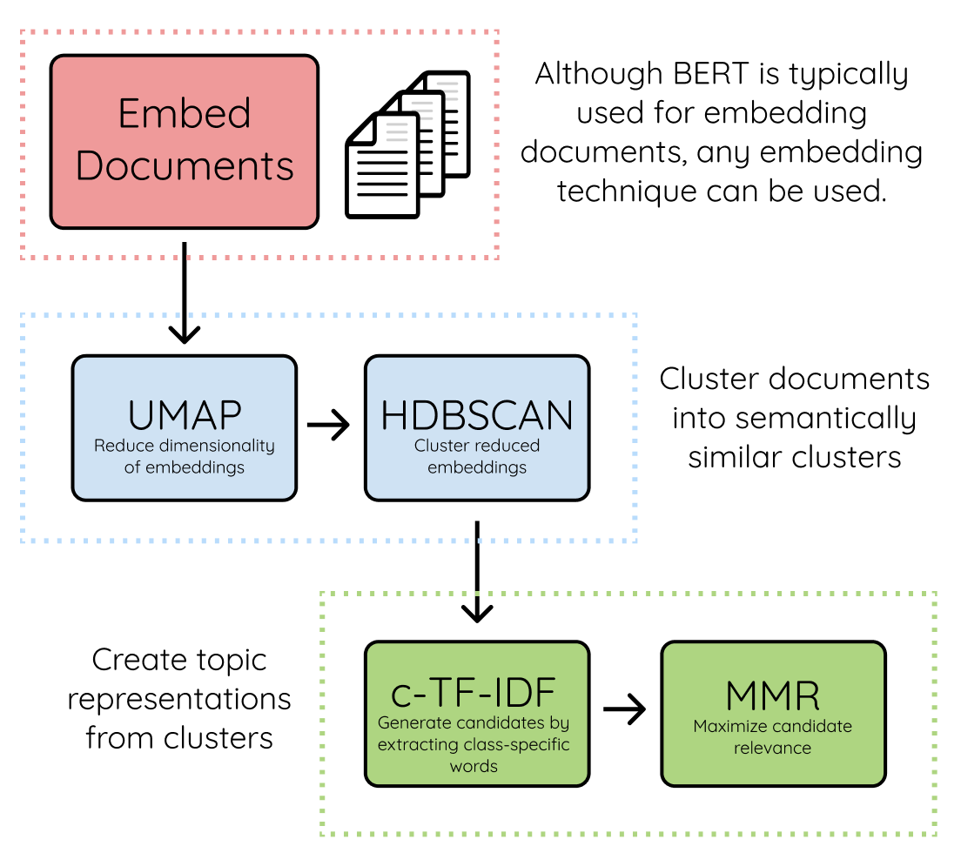
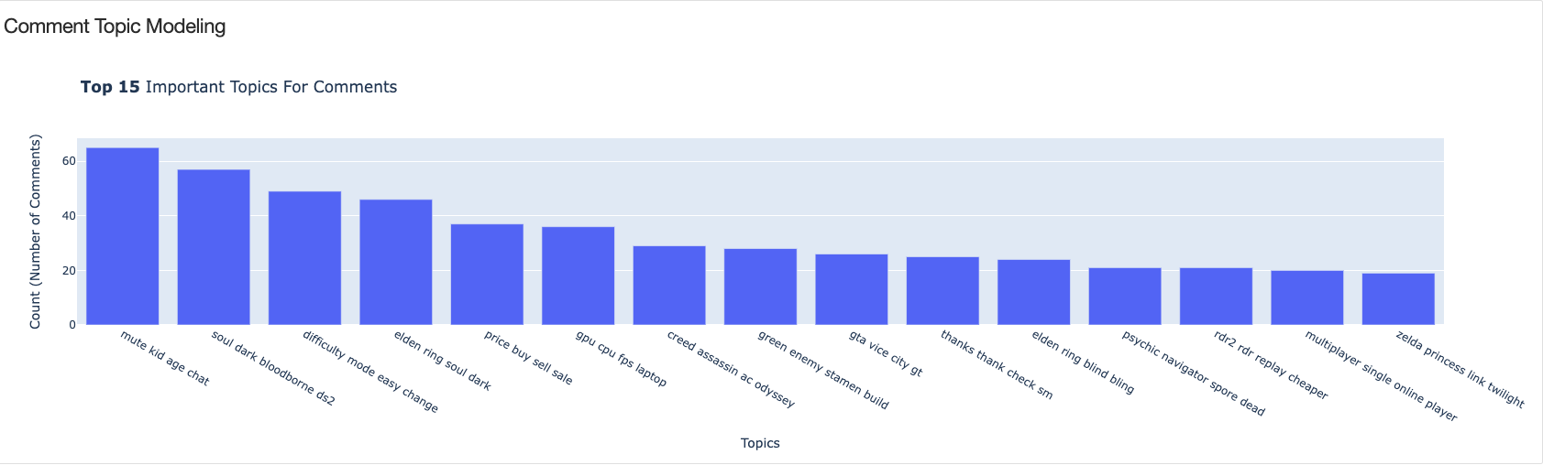
Identifying Topics BERTopic
BERTopic (maartengr.github.io)
r/Gaming
Notes:
For the technical aspects,
Great documentation.

Slide 11
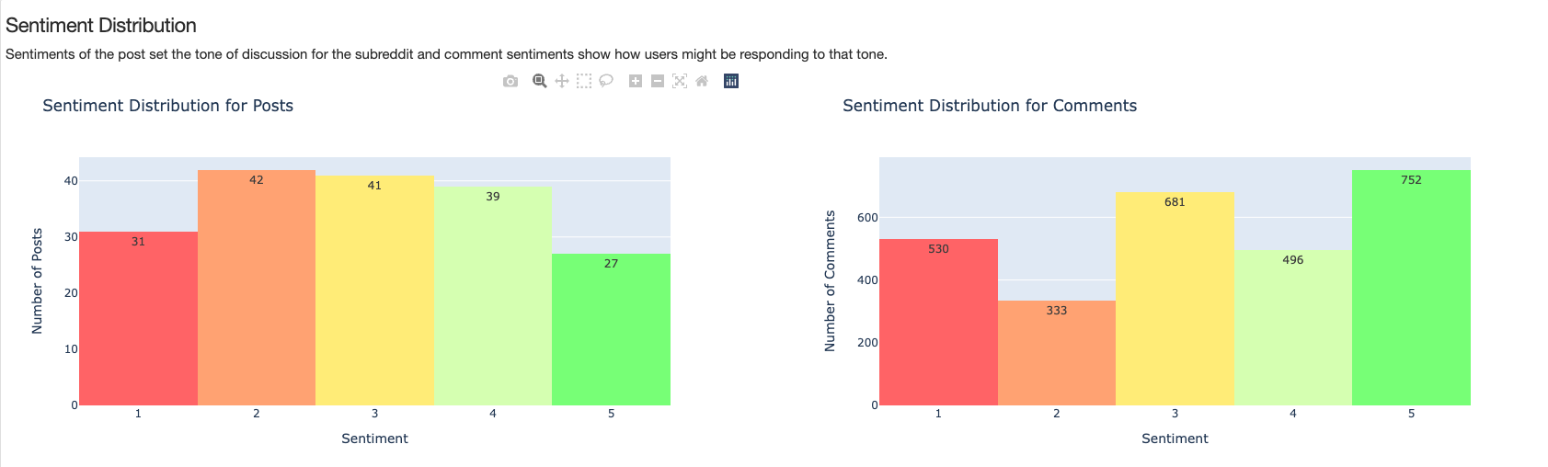
Identifying Conflict - Sentiment Analysis
Pretrained Hugging Face Transformers model: 'nlptown/bert-base-multilingual-uncased-sentiment'.
Hypotheses:
Sentiment deviation capture controversial opinions in discussions.
Negative sentiments usually highlight conflict.
Notes:
The sentiment analysis component is implemented using the pretrained Hugging Face Transformers model: 'nlptown/bert-base-multilingual-uncased-sentiment'.
This model is fine-tuned for sentiment analysis in six languages. It predicts the sentiment of each post’s body text and comments as a rating between 1 (negative) and 5 (positive).
Each submission is assigned a sentiment score for each rating and the rating with the highest score is deemed as the sentiment for that submission.
We believe posts sentiment set the tone for discussion and negative comment sentiment might indicate conflict.

Slide 12
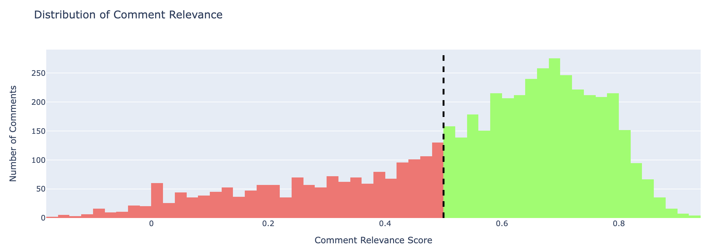
Determining Comment Relevance
How relevant are comments to their original post?
Using cosine similarity (distance) between BERT embeddings for posts and comments
Notes:
The final component we use in our TSAR system is relevance. We want to determine if comments of a post are still relevant to the post or not.
We believe that if the comments become irrelevant to the post, it is likely the comments aren't adding any meaningful discussion to the post overall, which is likely to result in higher controversy.
We calculate a relevance score for each comment by taking the cosine similarity between the comments BERT embedding and the post BERT embedding.
Here we have an example of the distribution of comment relevance to their post for the computer science subreddit. The green sections are all the comments that are relatively relevant and the red sections are all comments that were deemed relatively irrelevant to their posts.
We also perform a statistical test called Wilcoxon test here. We essentially test if median of the comment relevance is less than 0.5. And if the test turns out to be significant, we can conclude that overall the comments in the subreddit are irrelevant to their posts.

Slide 13

Further Discussion
Echo Chambers
Social Media Forum Bullying
Questions?
Suggestions?
Comments?

Slide 14

Thank you
https://github.com/reddit-conflicting-viewpoints/Reddit
Notes:
Thanks Brad and Mackenzie

Slide 15
Appendix

Slide 16
Raw Data
Asynchronous Python Reddit API Wrapper (AsyncPRAW)
49 subreddits
Latest posts categorized as ‘hot’ by Reddit
Limits
Maximum of 1,000 posts per subreddit
Maximum of 100 comments per post
Maximum of 10,000 comments per subreddit

Slide 17
Pre-Processing Data
Removed NULL and empty posts/comment texts
Removed any URLs in the posts/comments
Expanded Contractions (e.g. isn't -> is not)
Made all text lower case
Filtered out stop words (e.g. the, a)
Lemmatized the words
Lemmatization is the grouping together of different forms of the same word.
(e.g. apples -> apple, is -> be)
Ready to be fed into BERT
Notes:
So before we feed our text data into BERT, the machine algorithm for text that we used, we preprocessed our text.
The preprocessing included the following:
Removing empty text values
Removing any URLs that were mentioned in the text. This was done because there were a lot of URLs mentioned in the posts and comments, which led to non-sensical URL topics generated.
Expanded contractions
Made all the text lower case
Filtered out stop words
And finally lemmatized the words, which is grouping together different forms of the same word.
And now the model is ready to be fed into BERT.
We tried out many different combinations and ordering of preprocessing this text data, and this method yielded the best result.
For those of you that are familiar with BERT, might notice that we actually did too much preprocessing here. That is correct, and there is more room for improvement here. For example, BERT performs better without removing stop words and lemmatization because BERT uses those words for context. And we should move some parts of our preprocessing until after the BERT model has generated results.

